Slide 1
FATIGUE OF MATERIALS & STRUCTURES
G. Hénaff
1

Slide 2
Fatigue Crack propagation

Slide 3
Opening modes
Opening
In-plane shearing
Out-of-plane shearing

Slide 4
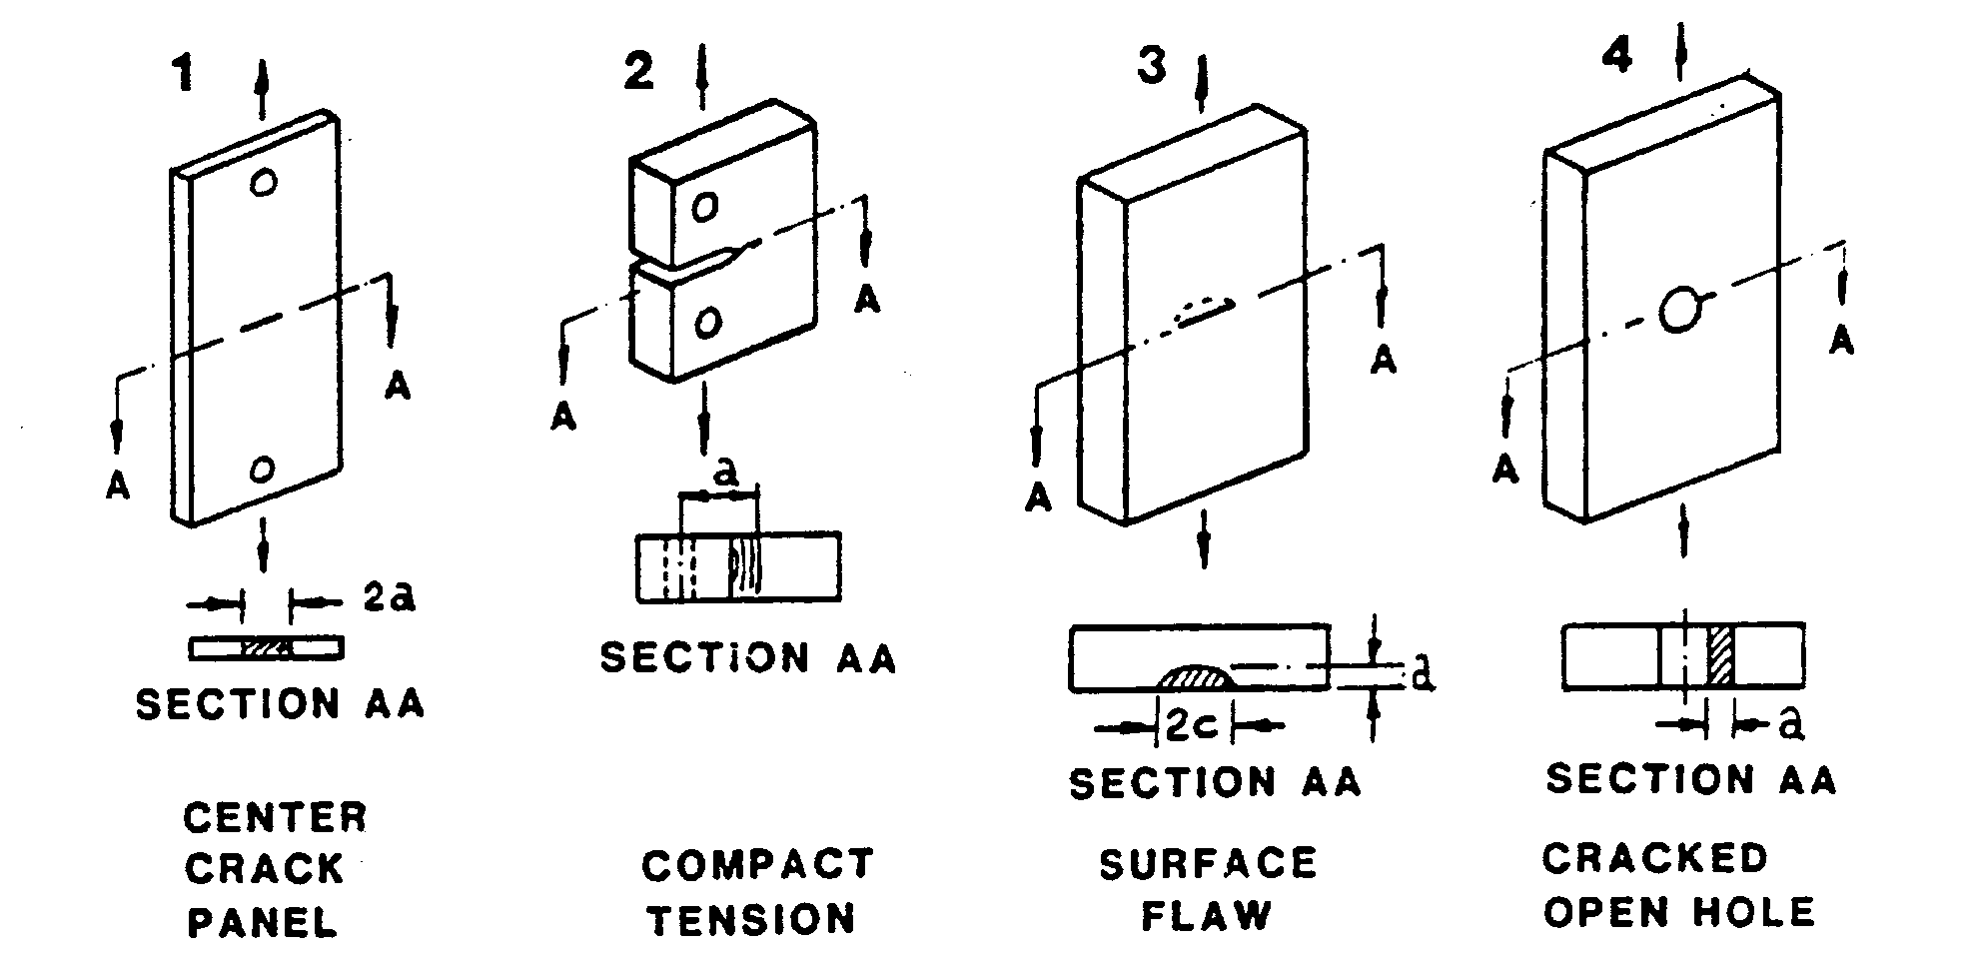
Standard specimens

Slide 5
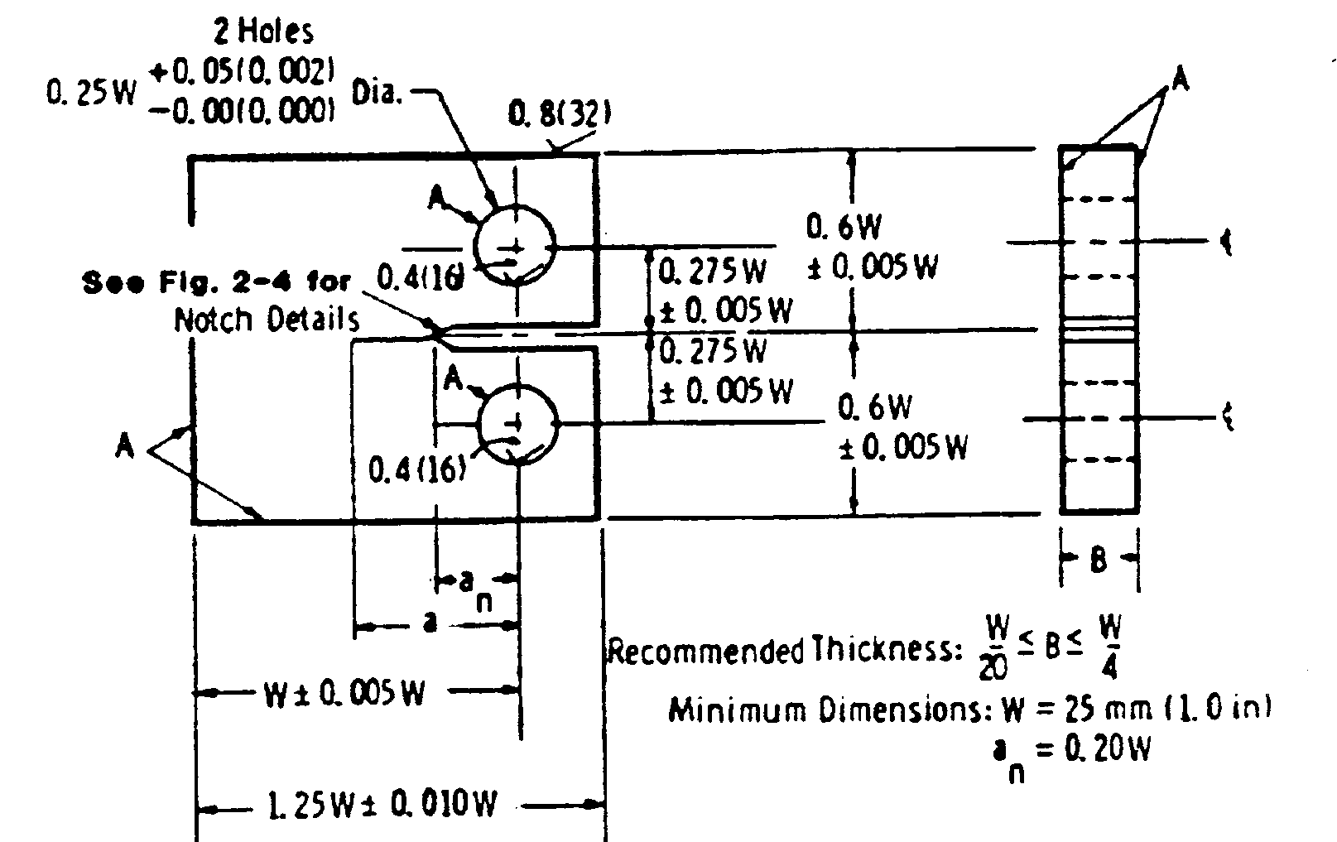
Compact tension specimen

Slide 6
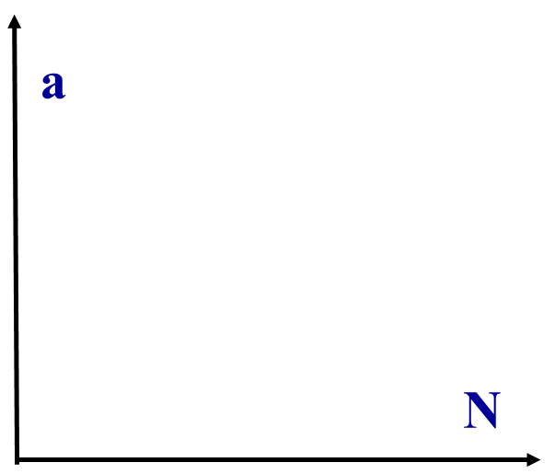
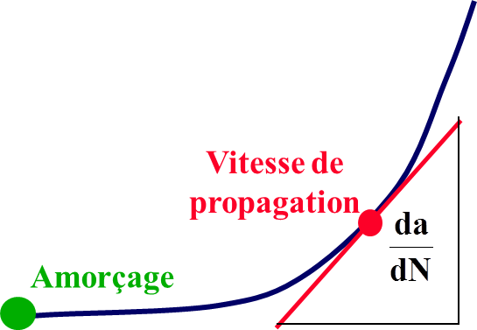
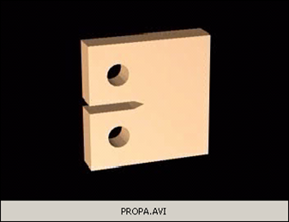
Fatigue crack propagation test
Pre-cracked specimens
Crack length monitoring of the crack length as a function of the number of aplled cycles (optical, compliance, potential drop)
Crack growth rate
Initiation

Slide 7
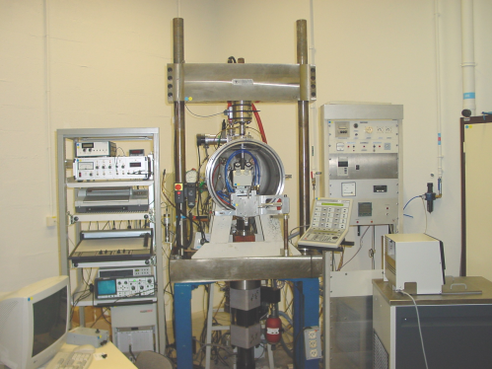
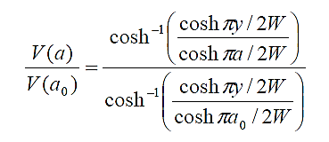
Crack length monitoring
Optical method (direct)
Variation of Compliance
Potential drop (requires a calibration)
P
δ
Extensometer

Slide 8
Propagation curves
a
High Δσ
Low Δσ
Slope da/dN
a₀
N
10000
20000
30000
40000

Slide 9
Use of LEFM
Static or monotonic loading: the stress intensity factor accounts for the stress/strain field at the crack tip

Slide 10
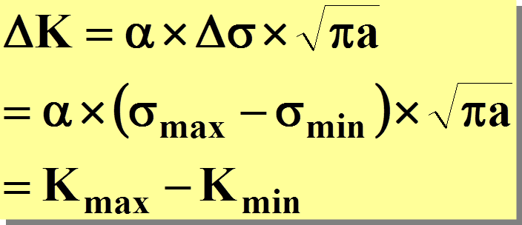

Use of LEFM
Idea: consider the stress intensity factor range ΔK as the driving force for crack growth under cylic loading
NB: even when Δσ is kept constant, ΔK increases during crack growth

Slide 11
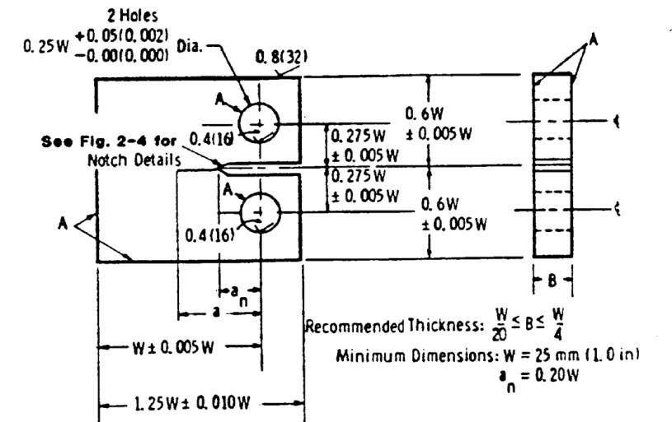
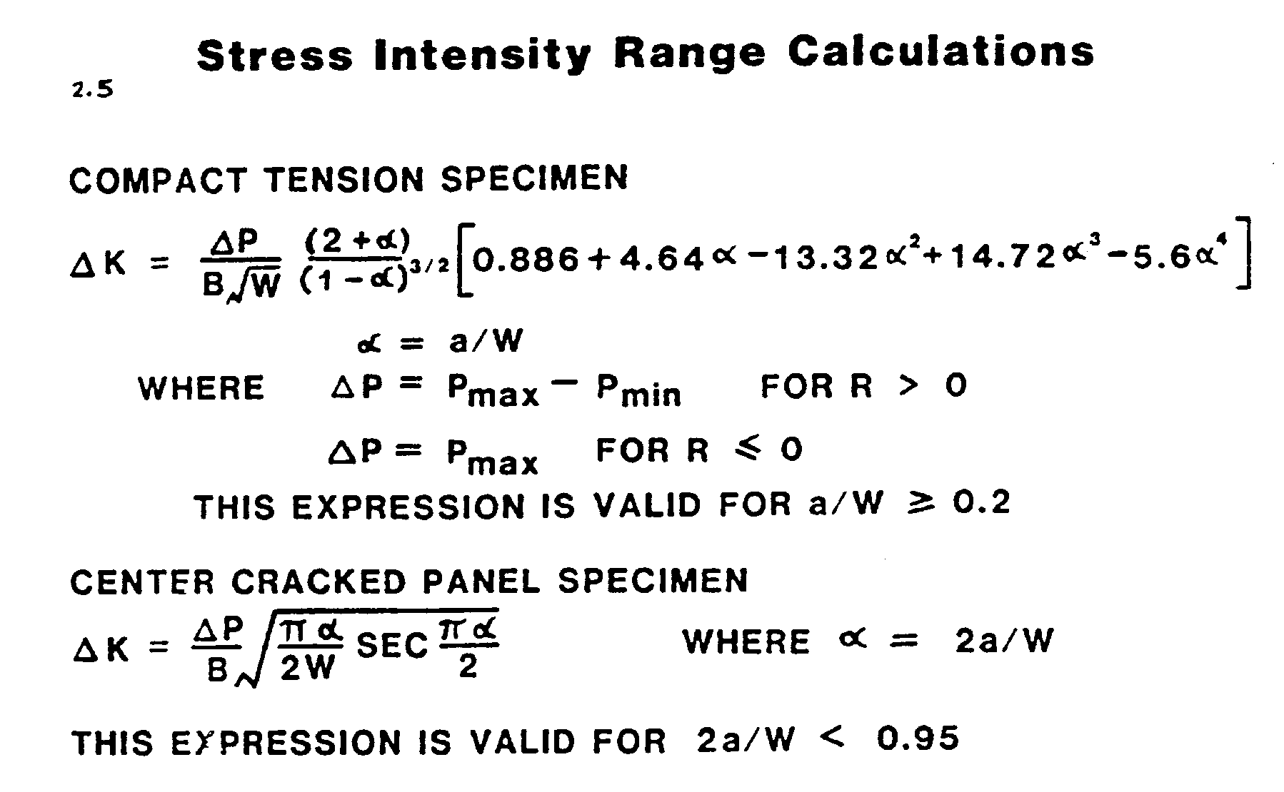
Stress intensity factor

Slide 12
LEFM concepts
Depends on specimen geometry, initial crack size, applied stress range, …
Crack growth rate
Initiation
Principle of similarity: a given value of ΔK (for a wide variety of σ and a values) induces the same cyclic stress/strain field at the crack tip, therefore the same damage and as a consequence the same crack growth rate

Slide 13
Principle of similarity
da/dN
High Δσ
da/dN
Same da/dN range
Low Δσ
Single curve
ΔK - da/dN
Crack length a
ΔK
a₀
Computation of ΔK (Δσ,a)

Slide 14
Paris correlation

Slide 15
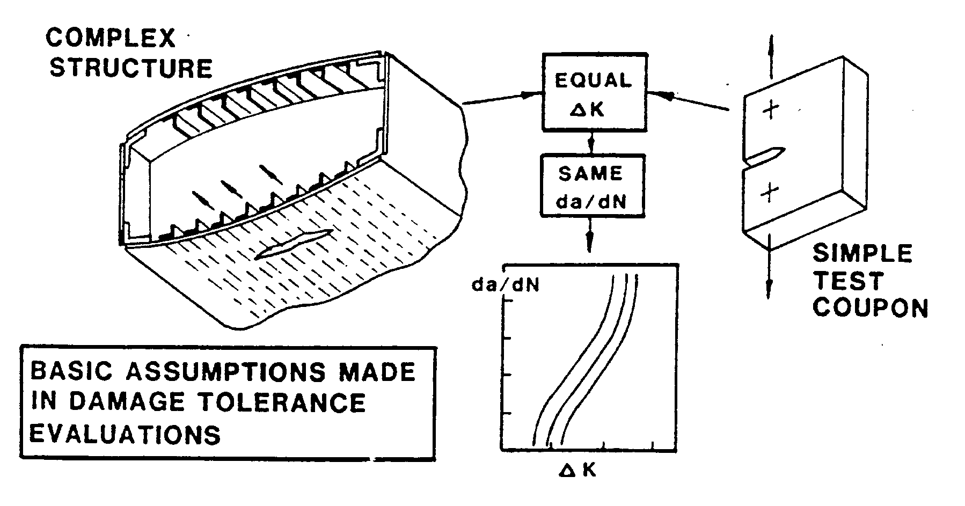
Transposability of laboratory data to structures

Slide 16
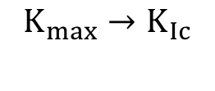
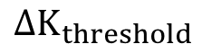
da/dN-ΔK curve
Influence of microstructure, load ratio
Crack growth rate at 50 Hz
da/dN
(m/cycle)
I
II
III
10⁻⁵
High
Weak
High
1 mm/minute
10⁻⁷
m
1 mm/hour
10⁻⁹
1 mm/day
1 mm/week
10⁻¹¹
ΔK
$${∆K}_{threshold}$$
$$K_{max}→K_{Ic}$$

Slide 17
Mechanisms

Slide 18
Cyclic deformation at the crack tip
σ
elasto-perfectly plastic behaviour
Far field loading
σ
2
σ _{y}
2
4
4
e
“Elastic domain”
= 2σ_{y}
t
1
1
3
- σ _{y}
s
3
σ _{y}
D
C
B
σ _{y}
B
C
D
monotonic PZ
A
A
O
R
M
r
e
- σ _{y}
- σ _{y}
F
E
E
F

Slide 19
Cyclic plastic zone size
monotonic PZ :
r
cyclic PZ:
Example: at R=0, the cyclic PZ size is 4 times smaller than the monotonic PZ size.

Slide 20
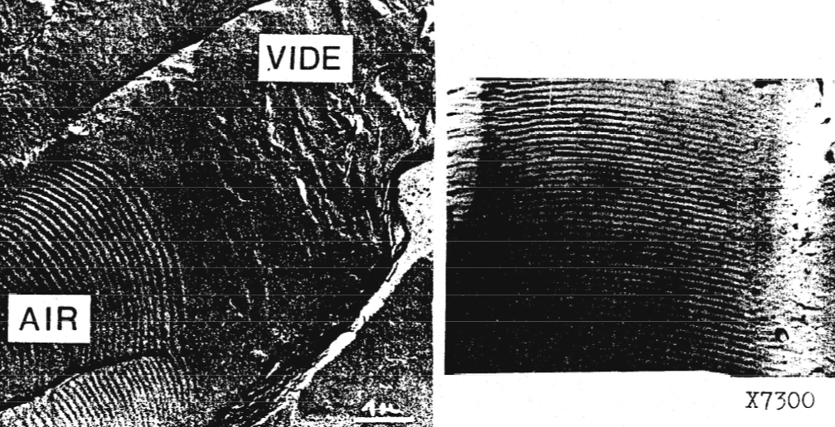
Propagation mechanisms: fatigue striations
Periodic markings on fracture surfaces;
Intermediate crack growth rate range (5x10⁻⁸ - 10⁻⁵ m/cycle);
Clearly defined in Aluminum alloys, much less in high strength alloys;
No striation in inert environment.

Slide 21
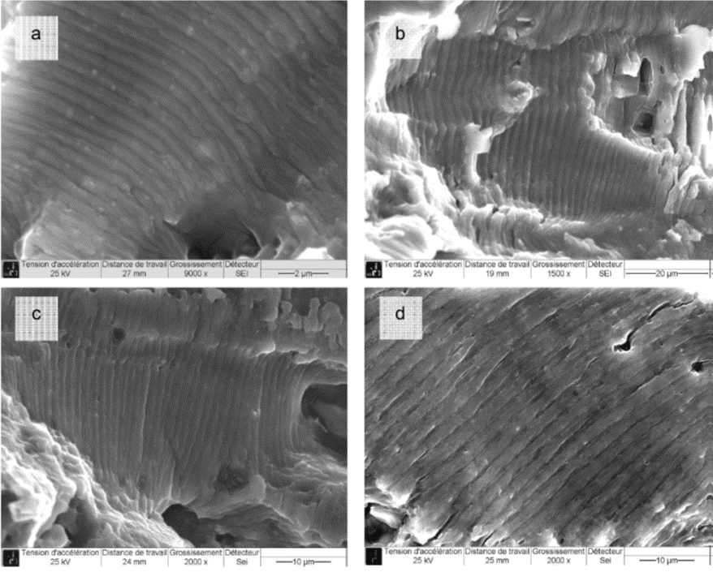
Propagation mechanisms: fatigue striations
Striations afte fatigue at R=0.1 in a 2024 T351 alloy from the teardown of a A320 MSN004 wing: tip, maximum stress 400 MPa (a) and 300 MPa (b); engine area maximum stress 275 MPa (c) et 300 MPa (d) (Thèse F. Billy, ENSMA)

Slide 22
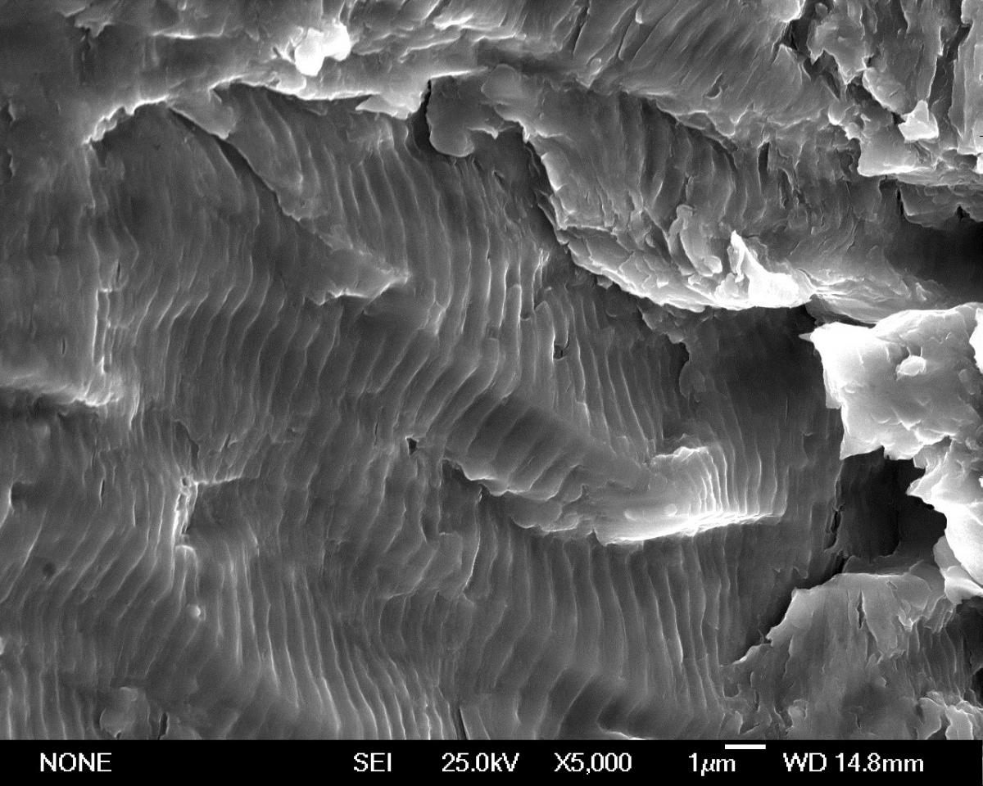
Mécanismes de Propagation : Stries de Fatigue
Striations in a precipition-hardened martensitic stainless steel used in aerostructures (thèse L. Dimithe-Aboumou, ENSMA)

Slide 23

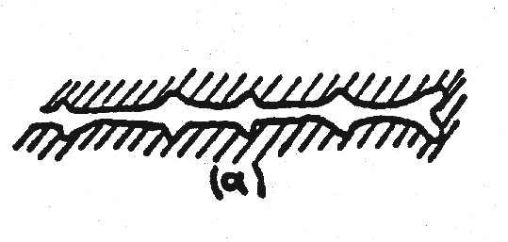
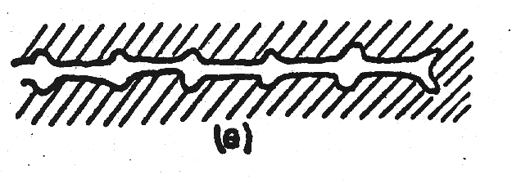
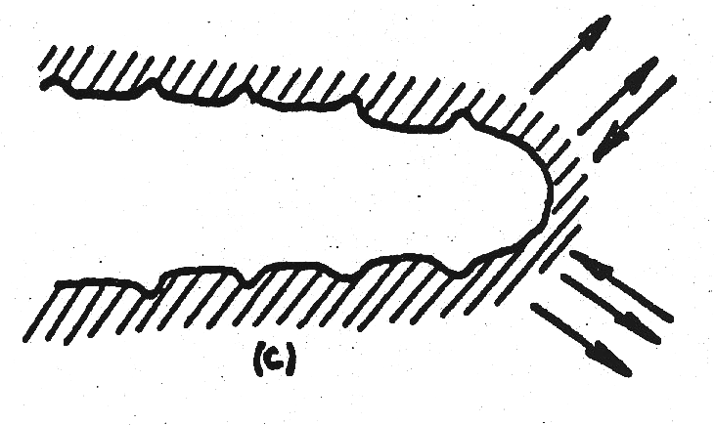
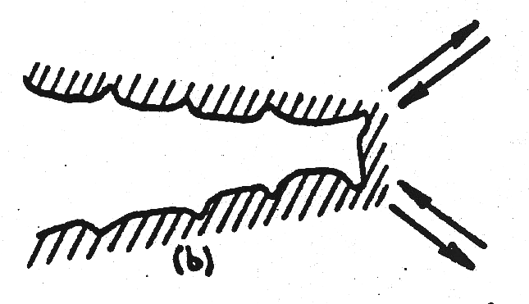
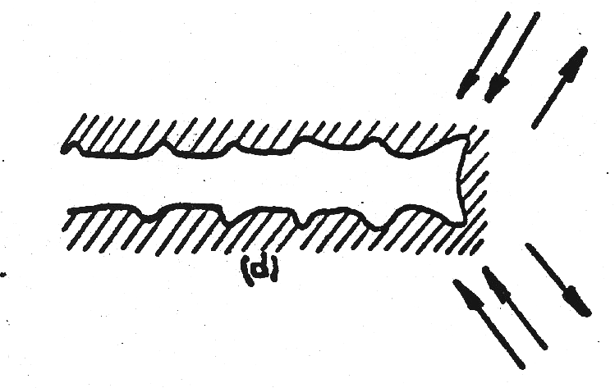
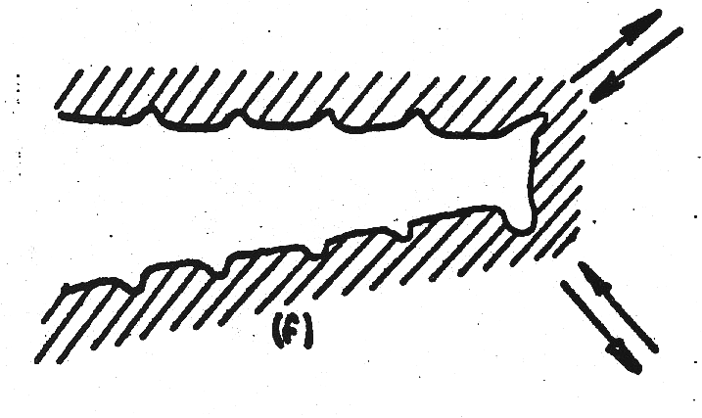
Striation formation: Laird mechanism
σ
σ
t
t
“Resharpening” of the crack tip
σ
σ
t
Crack tip blunting
t
σ
σ
t
t

Slide 24

Striation formation: Pelloux mechanism
Irreversible slip
(oxidation)
Reversible slip
(inert)
Dr. Regis Pelloux 1931 - 2015
→ Accounts for the absence of striation in vacuum
2 cycles
2 cycles

Slide 25
Propagation mechanisms in the near-threshold region
More brittle aspect of the fracture surfaces(cleavage-like fracture, intergranular decohesions,….)

Slide 26
Factors of influence

Slide 27
Influence of load ratio
da/dN
R increasing
When R increases:
- da/dN increases for a fixed value of ΔK;
- ΔK_{Threshold} decreases.
Low R value (typically 0.1)
ΔK

Slide 28
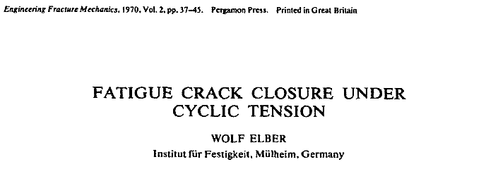

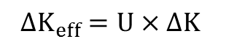
Crack closure
Experimental evidence that a fatigue crack , even when loaded in tension (R>0) can be partially closed during the lower part of the loading cycle.
ΔK_{eff}
Open crack
ΔK
Partially closed crack
Hyp : a crack can propagate only when it is fully open ⇒ da/dN fonction of ΔK_{eff}
Elber (1970):
$$ΔK_{eff}{=U×ΔK }_{}$$
For the 2024 T351 alloy in Paris regime:
$$U{=a+b×R }_{}$$

Slide 29
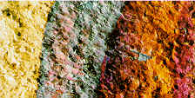
Crack closure sources
Plastic wake
Residual
mode II displacement
contact
Formation of a thick oxide layer ⇒ “wedge” effect”
Plasticity induced closure
Oxide induced closure
Roughness induced closure

Slide 30
Plasticity-Induced Closure
The material flow from the bulk that accumulates on the crack flanks, thereby giving rise to the premature contact as noted by Sun and Sehitoglu

Slide 31
Roughness-Induced Closure
Garcia and Sehitoglu modelled roughness-induced crack closure as a contact problem with random distribution of surface asperities.

Slide 32
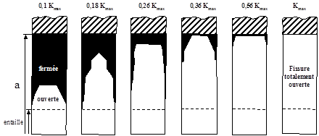
Opening kinematics
FEM Simulation of the crack opening in a CCT specimen (after Chermahini et al. 1988 ).

Slide 33
Experimental measurement of the crack opening load
P
δ
P
Compliance of open crack
Back-face strain gage
Compliance of the partially closed crack
δ

Slide 34
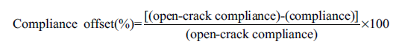
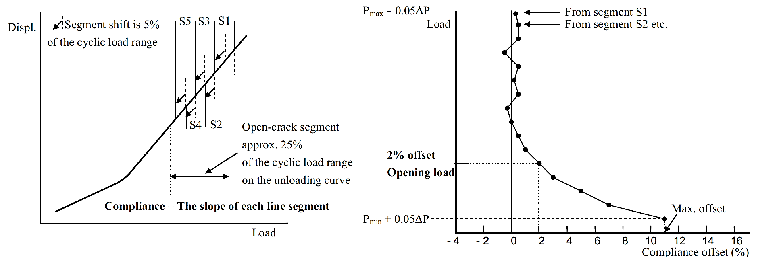
Experimental measurement of the crack opening load

Slide 35
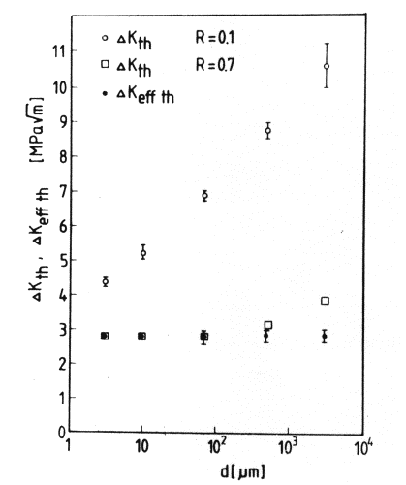
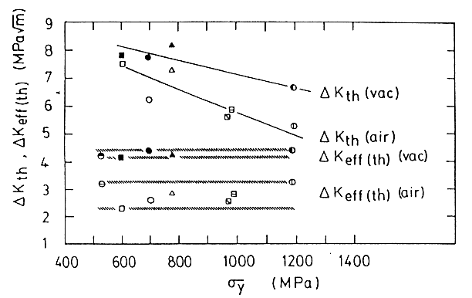
Influence of metallurgical parameters
Grain size
Yield strength
ARMCO iron
ΔK _{eff, th} (vac)
ΔK eff, th (air)
ΔK _{eff,th}
The higher the yield strength, the lower the threshold ↔ crack closure effect
The coarser the grain, the higher the threshold ↔ crack closure effect

Slide 36
Influence of environment
A moist environment induces a loss of resistance

Slide 37
Propagation assistée par l’hydrogène
H
M
H
Transport
 accès des espèces actives en pointe de fissure
 adsorption physique
Réaction de fragilisation
 adsorption chimique et dissociation
 pénétration et diffusion de l’hydrogène en pointe de fissure

Slide 38
Fatigue Crack Propagation Laws
Empirical Laws:
Forman
Paris
Theoretical approaches:
Cumulative damage at the crack tip
Manson-Coffin at the crack tip (McClintock, Antolovitch,…)
CTOD (Pelloux)

Slide 39
Intrinsic fatigue crack growth (inert,ΔK _{eff})
4
4
1
1

Slide 40
Short cracks
Def : cracks for which at least one dimension is small with respect to other dimensions (geometry, grain size,…)
da/dN
Short cracks from notches
Natural short cracks
Long cracks
Absence of threshold
a (crack length) or ΔK

Slide 41
Kitagawa diagram
log(Δσ)
Failure
Δσ_{D}
2
1
Non failure
a_{c}
log (a)

Slide 42
Kitagawa Diagram

